Slide 1
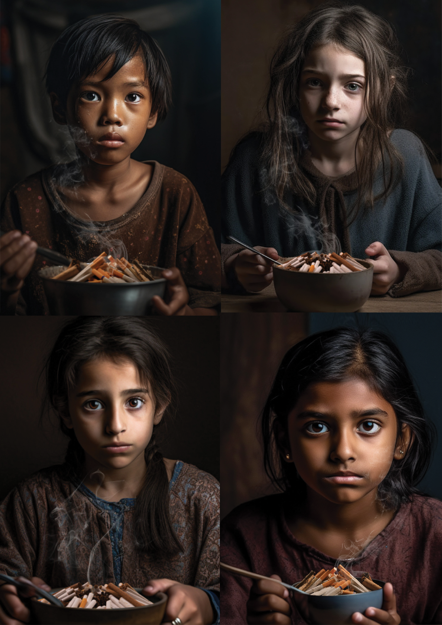

Grow
Food
Not
Tobacco
Tobacco crops
lead to
less food
on tables

Slide 2

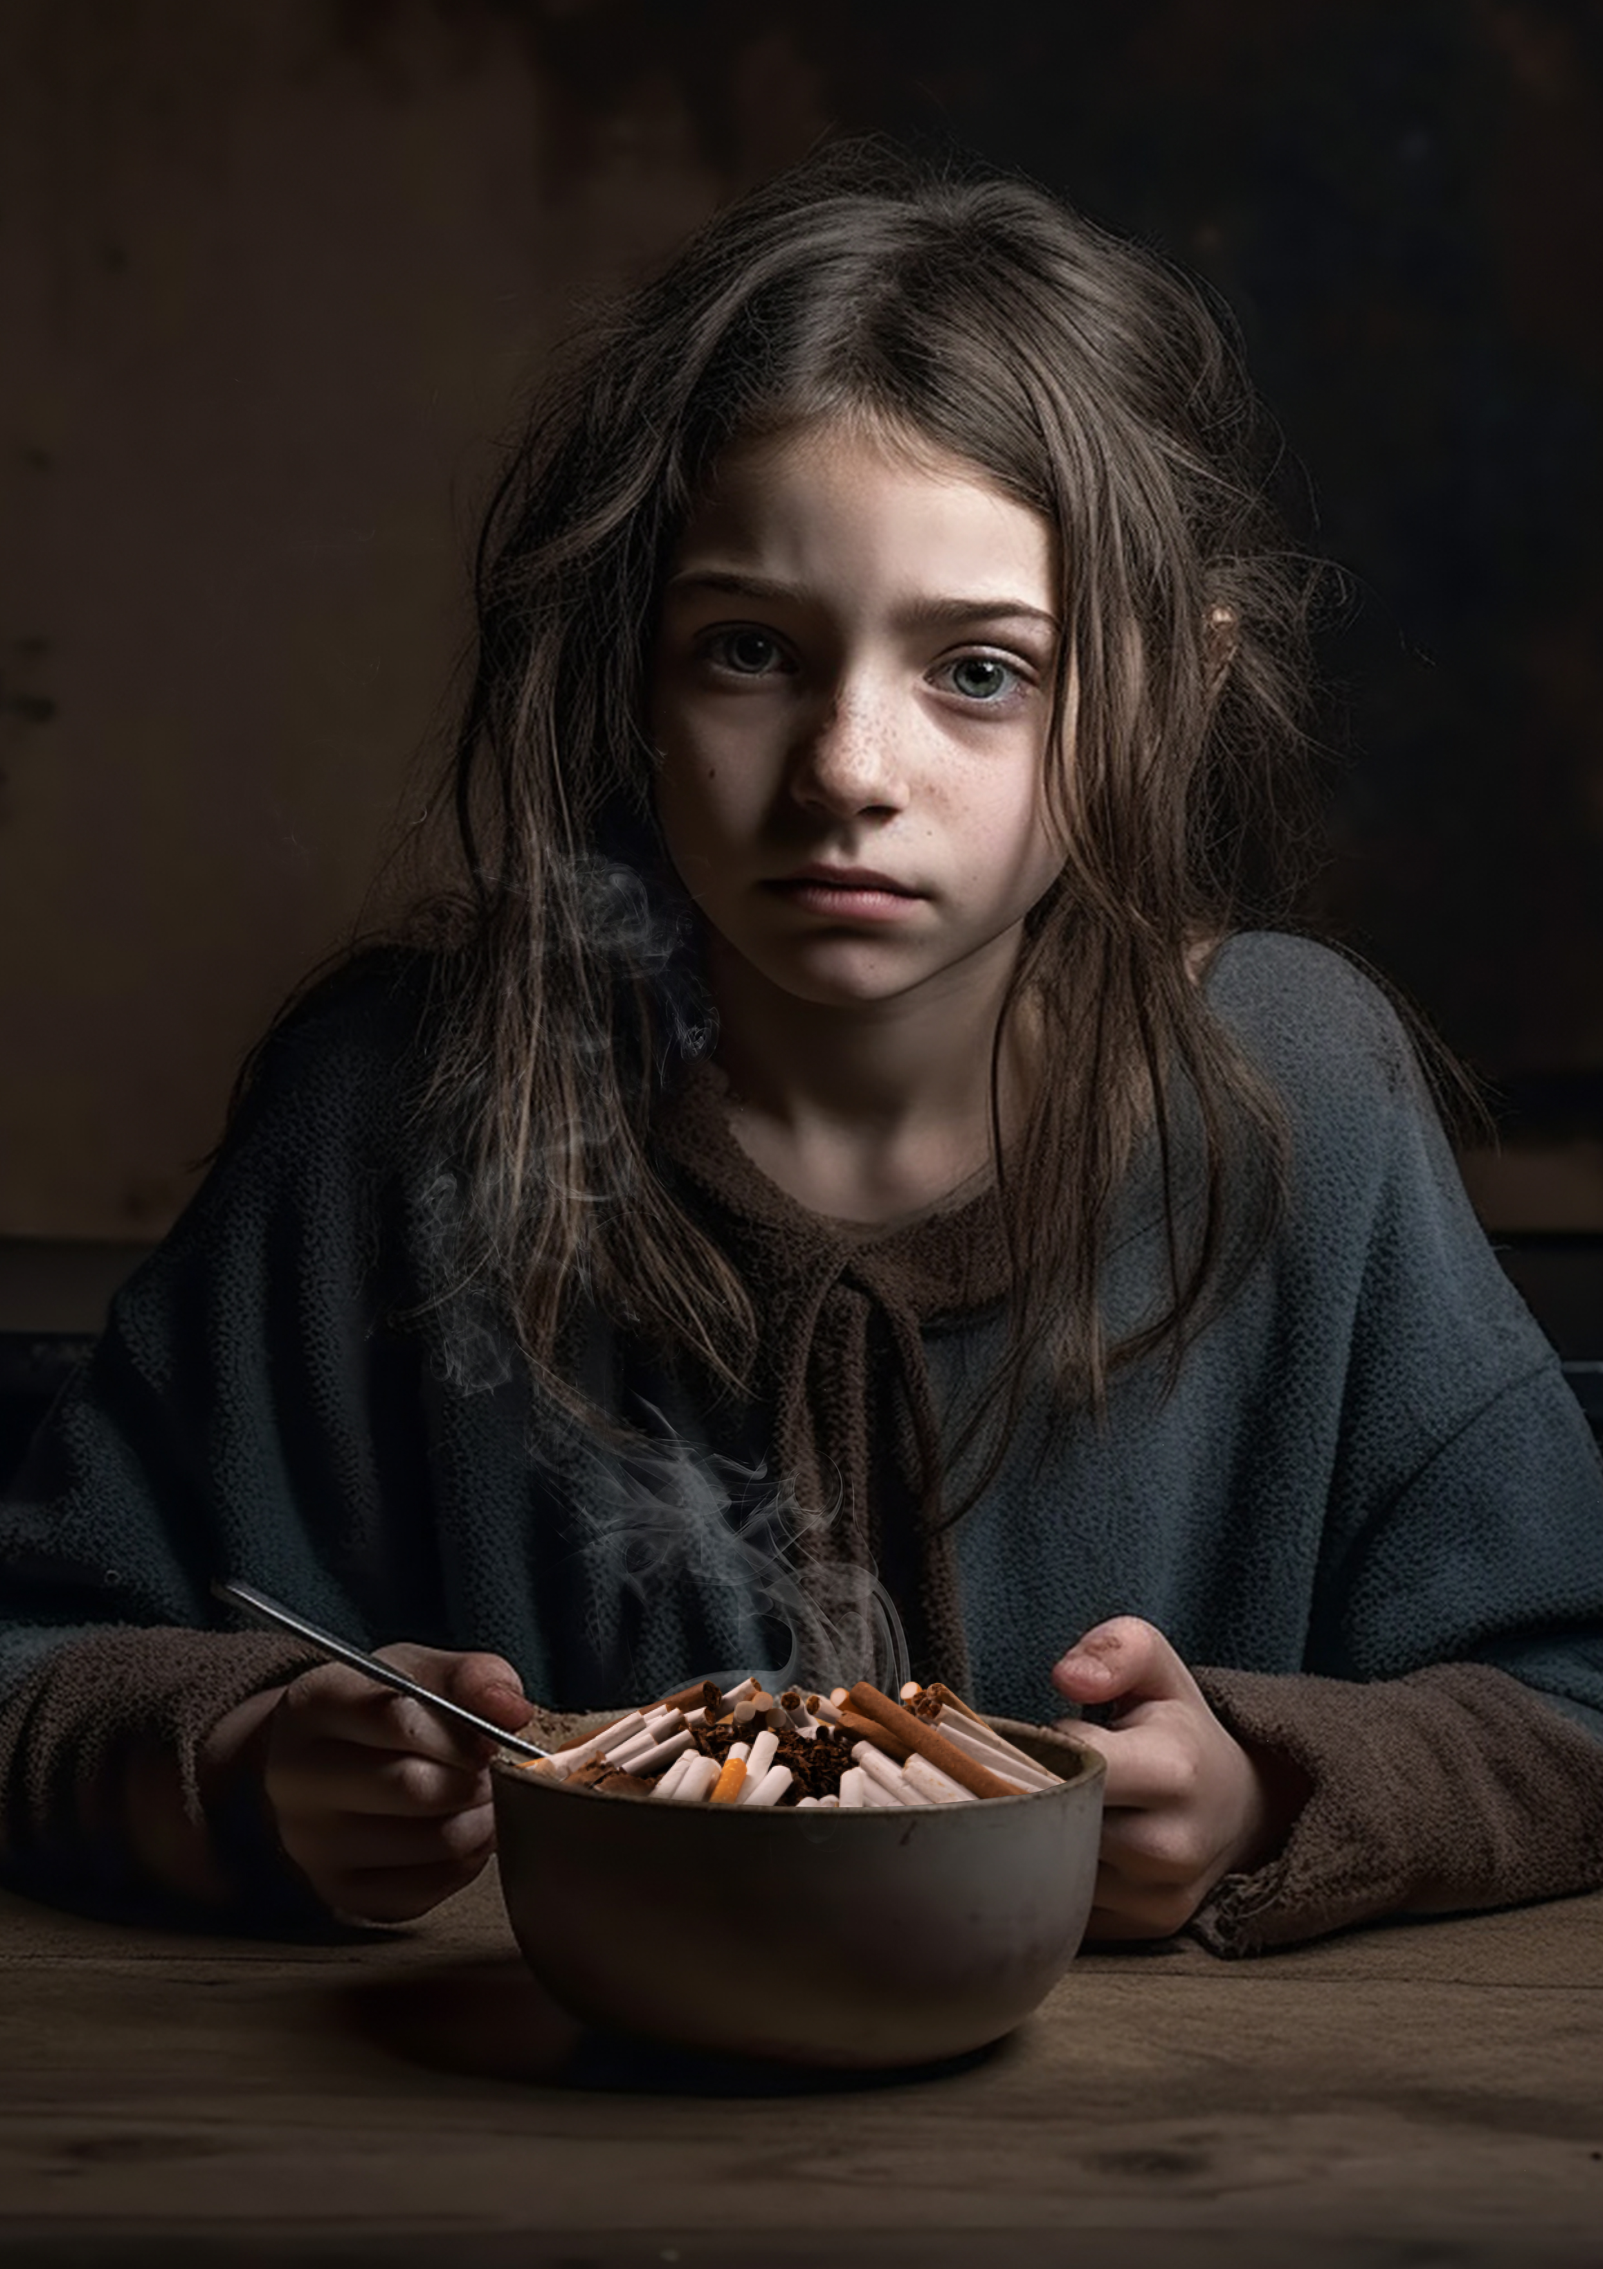
Grow Food Not Tobacco
Tobacco crops lead to less food on tables

Slide 3
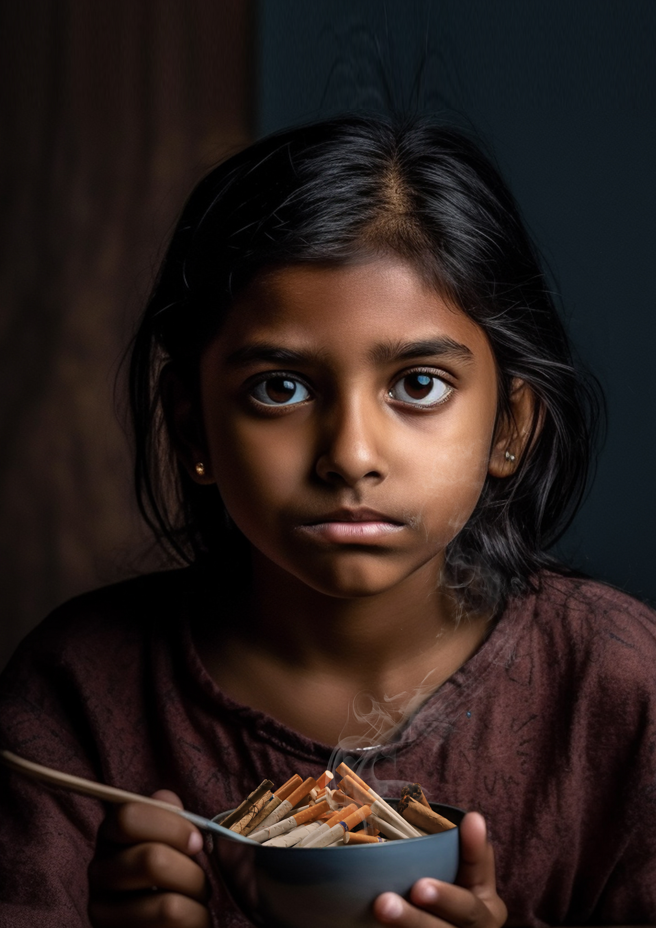
Grow Food Not Tobacco
Tobacco crops lead to less food on tables

Slide 4

Grow Food Not Tobacco
Tobacco crops lead to less food on tables

Slide 5
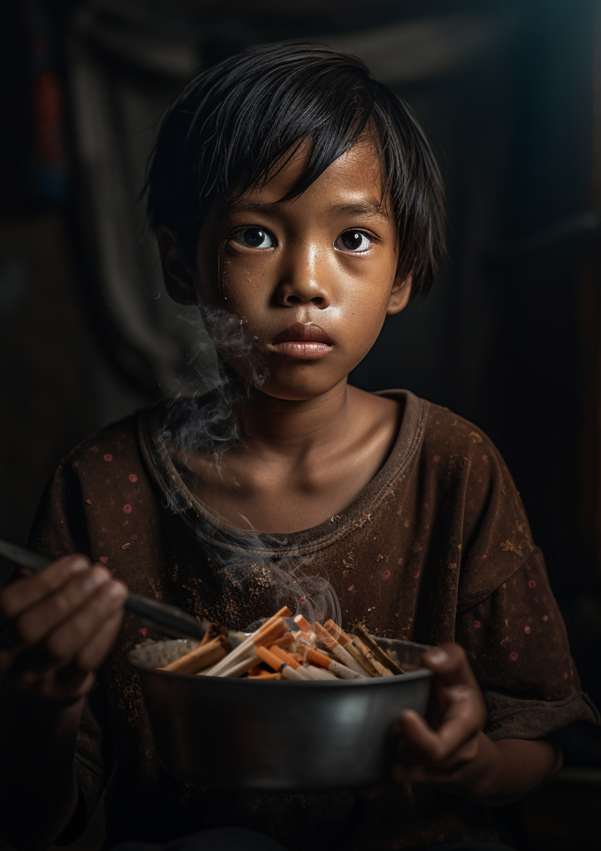
Grow Food Not Tobacco
Tobacco crops lead to less food on tables

Slide 6
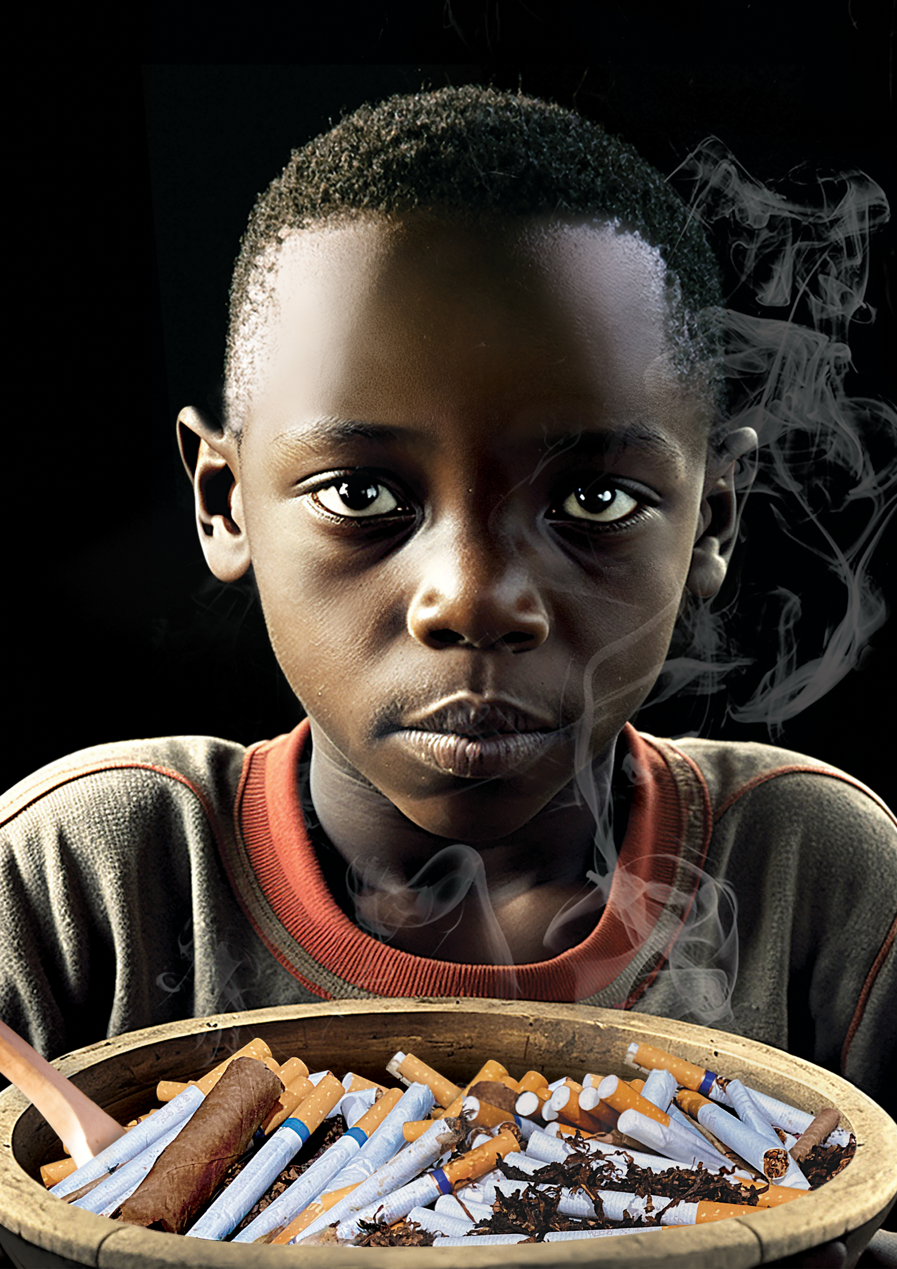
Grow Food Not Tobacco
Tobacco crops lead to less food on tables

